Slide 1
Chapter 3 Design Theory for Relational Databases

Slide 2
Objectives
Understand concepts of:
Functional Dependencies – phụ thuộc hàm
Normalization – chuẩn hóa
Decomposition – phân rã
Multi-valued Dependencies - Phụ thuộc đa trị

Slide 3
Contents
Functional Dependencies
Rules about FDs
Key & Super-Key
Normal forms

Slide 4
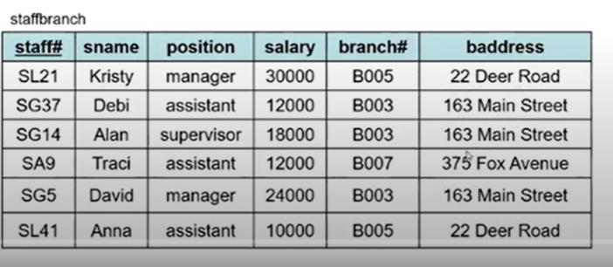
Functional dependency

Slide 5
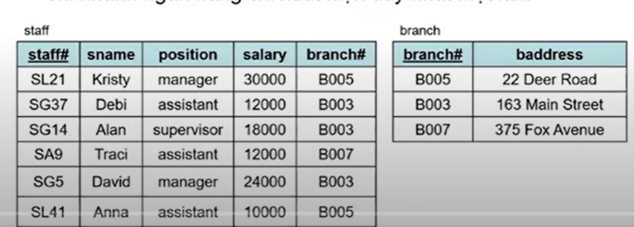
Functional dependency

Slide 6
Functional dependency
A functional dependency: constraint between two sets of attributes in a relation
A set of attributes X (include A₁A₂…A_{n}) in R functionally determine another attribute Y (include B₁B₂…B_{m}), also in R, (written X → Y) if and only if each X value is associated with precisely one Y value
A functional dependency A₁A₂…A_{n} → B₁B₂…B_{m} holds on relation R if two tuples of R agree on all of the attributes A₁, A₂, …, A_{n} then they must also agree on all of the attributes B₁, B₂, …, B_{m}

Slide 7
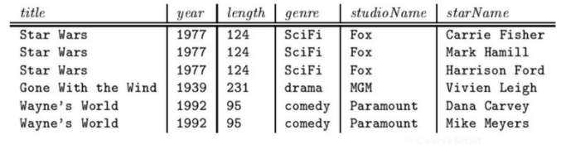
Functional dependency
Easy to see that: the following FD is true
title,year → length, genre, studioName
Exercise: How about the FD
title,year → starName
title, year → startName does not hold in Movies1 relation
Notes:
Give Movie relation, answer below questions:
1. What are the keys of relation?
2. What if we ignore the column starName?
3. Can starName be a key?
Easy to see that: the following FD is true
title,year → length, genre, studioName
Exercise: How about the FD
title,year → starName
title, year → startName does not hold in Movies1 relation

Slide 8
Functional dependency
Review key of relation, candidate keys(alternate keys), primary key
Super-key
A set of attributes that contains a key is called a super-key
Every super-key satisfies the first condition of a key: it functionally determines all other attributes of the relation
If K is a key, L is a super key, then: K ⊆ L
A key is also a super key

Slide 9
Functional dependency
Armstrong’s Axioms
Fundamental Rules: Let X, Y, Z are sets of attributes
Reflexivity(Luật phản xạ):
If X is a subset of Y, then Y→X
Augmentation (Luật tăng trưởng)
If X→Y, then XZ→YZ for any Z
Transitivity (Luật bắc cầu)
If X→Y and Y→Z, then X→Z
Additional rules: Let X, Y, Z, W are sets of attributes
Union/Combining(Luật cộng thêm): if X→Y AND X→Z then X→YZ
Decomposition/Splitting(Luật chiếu): if X→YZ, then X→Y and X→Z
Pseudotransitivity(Giả bắc cầu): If X → Y and WY → Z then WX →Z
Trivial FDs: right side is a subset of left side
Ex: FLD →FD

Slide 10
Functional dependency
A set of FD’s S follows from a set of FD’s T if every relation instance that satisfies all the FD’s in T also satisfies all the FD’s in S
Two sets of FD’s S and T are equivalent if and only if S follows from T, and T follows S

Slide 11
Example 3.1
relation R(A,B,C,D,E,G,H)
A set of functional dependencies
F={ AB→C, B→D, CD →E, CE →GH, G →A}
Use the Armstrong axioms to prove the following deductions AB → E

Slide 12
Example 3.2
Relation R(A,B,C,D,E,G,H, I, J)
A set of functional dependencies
F={ AB→E, AG→J, BE →I, E →G, GI →H}
Use the Armstrong axioms to prove the following deductions AB → GH

Slide 13
The Closure of Attributes
The closure of a set of attributes {A₁, A₂, …, A_{n}} under FD’s in S (denoted {A₁, A₂, …, A_{n}}⁺) is the set of attributes B such that every relation that satisfies all the FD’s in set S also satisfies A₁A₂…A_{n}→ B
That is, A₁A₂…A_{n}→ B follows from the FD’s of S
A₁, A₂, …, A_{n} ∈ {A₁, A₂, …, A_{n}}+, because A₁A₂…A_{n}→A_{i} is trivial

Slide 14
The Closure of Attributes
Algorithm 3.7: Closure of a set of attributes
Input: A set of attributes {A₁,A₂,…,A_{n}} and a set of FD’s S
Output: The closure {A₁,A₂,…,A_{n}}⁺
If necessary, split the FD’s of S, so each FD in S have singleton right side
Let X be a set of attributes that will become the closure. Initialize X to be {A₁,A₂,…,A_{n}}
Repeatedly search for some FD: B₁B₂…B_{m} → C, such that B₁, B₂, …, B_{m} are in X, but C is not
If such C is found, add to X, and repeat the search
If such C is not found, no more attributes can be added to X
The set X is the correct value of {A₁, A₂, …, A_{n}}+

Slide 15
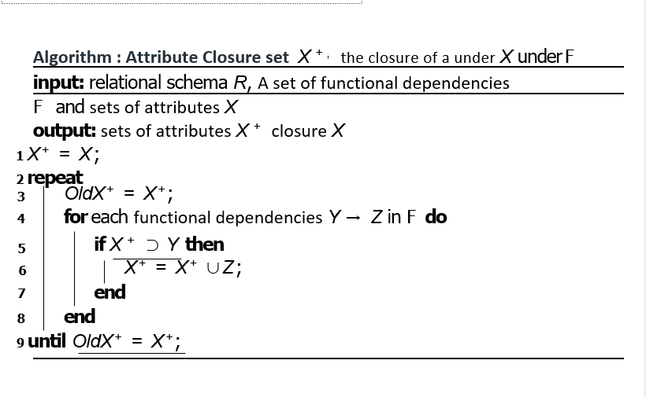
The Closure of Attributes

Slide 16
The Closure of Attributes
R(A, B, C, D)
S={A→B, B→C, C→D, D→A}
Compute {A}⁺ ? {B}⁺ ?
What are some the keys of R?

Slide 17
The Closure of Attributes
Example 3.3
U = {A, B, C, D, E, G}
F = {AB → D, A → G, C → E, GE → B}
Compute {AC}⁺ ?
---------------------------------------------------------------------------------------
Example 3.4
R = (U, F) , U= {A,B,C,D,E,G,H}
F= {AB→C, D→EG, ACD→B, C→A, BE→C, CE→AG, BC→D, CG→BD, G→ H}
{D}+ ? {DE}+ ? {BE}+ ?
{CG}+ ?

Slide 18
Closing Sets of Functional Dependencies
Suppose a set of FD’s S, any set of FD’s T equivalent to S is said to be a basis for S. Then we say T is a basis for S
Just work with only FD’s that have singleton right sides
A minimal basis for FD’s S is a basis B that satisfies three conditions:
All the FD’s in B have singleton right sides
If any FD is removed from B, the result is no longer a basis
If for any FD in B we remove one or more attributes from the left side, the result is no longer a basis

Slide 19
Closing Sets of Functional Dependencie
⬥ Relation R(U), U={A, B, C, D},
⬥ F = { A → B, B → C, A → D, B → D}
⬥ F⁺ ?
✓ {A → B & B →C} ⇨ A → C ⊆ F⁺ (Transitivity)
✓ {B → C & B →D} ⇨ B → CD ⊆ F⁺ (Union)
✓ {A → B & A →C} ⇨ A → BC ⊆ F⁺ (Union)
✓ {A → B & A →D} ⇨ A → BD ⊆ F⁺ (Union)
✓ {A → BD & A →C} ⇨ A → BDC ⊆ F⁺ (Union)
✓ …

Slide 20
Closing Sets of Functional Dependencie
⬥ Relation R(U), U={A, B, C, X, Z},
⬥ F = { A → B, C → X, BX → Z}
⬥ { AC → Z} ⊆ F⁺ ?
1. A → B (hypothetically)
2. AX → BX (Augmentation)
3. BX → Z (hypothetically)
4. AX → Z (Transitivity 2&3)
5. C → X (hypothetically)
6. AC → AX (Augmentation)
7. AC → Z (Transitivity 6&4)

Slide 21
Closing Sets of Functional Dependencies
Example
R(A,B,C)
S={A→ B, A → C, B → A, B → C, C → A, C → B, AB → C, BC → A, AC → B, A → BC, B → AC, C → AB}
R and its FD’s have several minimal basis
{A → B, B → A, B → C, C → B}, or
{A → B, B → C, C → A}

Slide 22
What happens to …
… a set of FD’s S of R when we project R on some attributes?
That is, suppose a relation R with set of FD’s S, and R₁=π_{L}(R). What FD’s hold in R₁?

Slide 23
Projecting Functional Dependencies
To find a functional dependencies of projection, we
Follow from S, and
Involve only attributes of R₁

Slide 24
Projecting Functional Dependencies
Algorithm 3.12: Projecting a Set of FD’s
Input: R, R₁=π_{L}(R), S a set of FD’s that hold in R
Output: the set of FD’s that hold in R₁
Method:
T is the set of FD’s that hold in R₁. Initially, T is empty
For each set of attributes X of R₁, compute X+. Add to T all non-trivial FD’s X → A such that A is both in X+ and an attribute of R₁
Construct a minimal basis from T

Slide 25
Projecting Functional Dependencies
Algorithm 3.12: Projecting a Set of FD’s (cont)
Compute a minimal basis from T
If there is an FD F in T that follows from other FD’s in T, then remove F from T
Let Y → B is a FD in T , with at least two attributes in Y, and let Z is Y with one of its attributes removed:
If Z → B follows from the other FD’s in T (including Y → B), then replace Y → B by Z → B
Repeat the above steps in all possible ways until no more changes to T can be made

Slide 26
Projecting Functional Dependencies
Two notations
(1) Closing the empty set and the set of all attributes cannot yield a nontrivial FD
(2) If we have already knew that the closure of some set X is all attributes, then we cannot discover any new FD’s by closing supersets of X

Slide 27
Projecting Functional Dependencies
Example: Suppose R(A,B,C,D) has FD’s A→B, B→C, and C→D. R1=π_{A,C,D}(R). Find the FD’s of R1?
Compute the closure of the singleton set
{A}+={A,B,C,D}, and B is not in R1, then new FD’s A→C, A→D
{C}+={C,D}, then new FD’s C→D
{D}+={D}, no new FD’s
Compute the closure of the doubleton set
Since {A}+ include all attributes, no care any more for supersets of {A}
{C,D}+={C,D}, no new FD’s holds in R1
Finally, there are three FD’s A→C, A→D, C→D hold in R1
A→D is transitive from A→C, and C→D
So, minimal basis is {A→C, C→D}

Slide 28
Anomalies (Dị thường) introduction
Careless selection of a relational database schema can lead to redundancy and related anomalies
So, in this session we shall tackle the problems of relational database designing
Problems such as redundancy that occur when we try to cram too much into a single relation are called anomalies

Slide 29
Anomalies
The principal kinds of anomalies that we encounter are:
Redundancy: information maybe repeated unnecessarily in several tuples (exp: the length and genre)
Update Anomalies: We may change information in one tuple but leave the same information unchanged in another (exp: if we found that Star Wars is 125 minutes long, we may change the length in the first tuple but not in the second and third tuples)
Deletion Anomalies: If a set of values becomes empty, we may lose other information as a side effect (exp: if we delete “Fox” from the set of studios, then we have no more studios for the movie “Star Wars”

Slide 30
Decomposition - phân hủy
The accepted way to eliminate anomalies is the decomposition of relations
Decomposition of a relation R involves splitting the attributes of R to make the schemas of 2 new relations
Definition: Given a relation R(A₁,..,A_{n}), we say R is decomposed into S(B₁,..,B_{m}) and T(C₁,..,C_{k}) if: + {A₁,..,A_{n}} = {B₁,..,B_{m}} U {C₁,..,C_{k}} + S = ∏_{B1,..Bm}(R) + T = ∏_{C1,..,Ck}(R)

Slide 31
Example: Decomposition

Slide 32
Discuss
The redundancy is eliminated (the length of each film appears only once)
The risk of an update anomaly is gone (we only have to change the length of Star Wars in one tuple)
The risk of a deletion anomaly is gone (if we delete all the stars for Gone with the wind, that deletion makes the movie disappear from the right but still be found in the left)

Slide 33
Decomposition: The Good, Bad and Ugly
We observed that before we decompose a relation schema into BCNF, it can exhibit anomalies; That’s the “Good”
However, decomposition can also have some bad:
Maybe we can’t recovery the original information; OR
After reconstruction, the FDs maybe not hold

Slide 34
Example: Loss of information after decomposition
Suppose we have R(A,B,C) but neither of the FD’s B->A nor B->C holds.
R is decomposed into R1 and R2 as above
When we try to re-construct R by Natural Join of R1 and R2, we have: R3 = R1 X R2 (but R3 <> R1 => We lost information)

Slide 35
Example: Dependency Loss
If we check the projected FD’s in the relations of the decomposition, can we can be sure that when we reconstruct the original relation from the decomposition by joining, the result will satisfy the original FD’s?

Slide 36
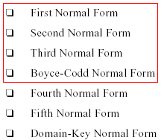
Normal Forms

Slide 37
Dependencies: Definitions
Multivalued Attributes (or repeating groups): non-key attributes or groups of non-key attributes the values of which are not uniquely identified by (directly or indirectly) (not functionally dependent on) the value of the Primary Key (or its part).
Partial Dependency – when a non-key attribute is determined by a part, but not the whole, of a COMPOSITE primary key.
Partial Dependency – when a non-key attribute is determined by a part, but not the whole, of a COMPOSITE primary key.
.

Slide 38

1NF
1NF A relation R is in first normal form (1NF) if and only if all underlying domains contain atomic values only
Take the following table.
StudentID is the primary key.
Is it 1NF?
Notes:
atomic values:
=one value for an attribute
= no repeating groups
= no multivalued attributes
= no composite attributes

Slide 39
No. There are repeating groups (subject, subjectcost, grade)
How can you make it 1NF?

Slide 40

Create new rows so each cell contains only one value
But now look – is the studentID primary key still valid?

Slide 41
No – the studentID no longer uniquely identifies each row
You now need to declare studentID and subject together to uniquely identify each row.
So the new key is StudentID and Subject.

Slide 42
So. We now have 1NF.
Is it 2NF?

Slide 43
2NF
A relation R is in second normal form (2NF) if and only if it is in 1NF and every non-key attribute is fully dependent on the primary key
StudentName & Address are dependent on studentID (which is part of the key)
But they are not dependent on Subject (the other part of the key)

Slide 44
And 2NF requires…
All non-key fields are dependent on the ENTIRE key (studentID + subject)

Slide 45
So it’s not 2NF
How can we fix it?

Slide 46
Make new tables
Make a new table for each primary key field
Give each new table its own primary key
Move columns from the original table to the new table that matches their primary key…

Slide 47
Step 1
STUDENT TABLE (key = StudentID)

Slide 48

Step 2
STUDENT TABLE (key = StudentID)
SUBJECTS TABLE (key = Subject)

Slide 49



Step 3
STUDENT TABLE (key = StudentID)
SUBJECTS TABLE (key = Subject)
RESULTS TABLE (key = StudentID+Subject)

Slide 50
Step 3
STUDENT TABLE (key = StudentID)
SUBJECTS TABLE (key = Subject)
RESULTS TABLE (key = StudentID+Subject)

Slide 51
Step 4 - relationships
STUDENT TABLE (key = StudentID)
SUBJECTS TABLE (key = Subject)
RESULTS TABLE (key = StudentID+Subject)

Slide 52
Step 4 - cardinality
STUDENT TABLE (key = StudentID)
1
Each student can only appear ONCE in the student table
SUBJECTS TABLE (key = Subject)
RESULTS TABLE (key = StudentID+Subject)

Slide 53
Step 4 - cardinality
STUDENT TABLE (key = StudentID)
1
SUBJECTS TABLE (key = Subject)
1
Each subject can only appear ONCE in the subjects table
RESULTS TABLE (key = StudentID+Subject)

Slide 54
Step 4 - cardinality
STUDENT TABLE (key = StudentID)
1
SUBJECTS TABLE (key = Subject)
1
A subject can be listed MANY times in the results table (for different students)
8
RESULTS TABLE (key = StudentID+Subject)

Slide 55
Step 4 - cardinality
STUDENT TABLE (key = StudentID)
1
SUBJECTS TABLE (key = Subject)
1
A student can be listed MANY times in the results table (for different subjects)
8
8
RESULTS TABLE (key = StudentID+Subject)

Slide 56
A 2NF check
STUDENT TABLE (key = StudentID)
1
SUBJECTS TABLE (key = Subject)
1
SubjectCost is only dependent on the primary key,
Subject
8
8
RESULTS TABLE (key = StudentID+Subject)

Slide 57
A 2NF check
STUDENT TABLE (key = StudentID)
1
SUBJECTS TABLE (key = Subject)
1
8
8
Grade is only dependent on the primary key (studentID + subject)
RESULTS TABLE (key = StudentID+Subject)

Slide 58
A 2NF check
STUDENT TABLE (key = StudentID)
1
Name, Address are only dependent on the primary key
(StudentID)
SUBJECTS TABLE (key = Subject)
1
8
8
RESULTS TABLE (key = StudentID+Subject)

Slide 59
But is it 3NF?
STUDENT TABLE (key = StudentID)
1
So it is 2NF!
SUBJECTS TABLE (key = Subject)
1
8
8
RESULTS TABLE (key = StudentID+Subject)

Slide 60
3NF
A relation R is in third normal form (3NF) if and only if it is in 2NF and every non-key attribute is non-transitively dependent on the primary key.
An attribute C is transitively dependent on attribute A if there exists an attribute B such that: A->B and B->C
Note that 3NF is concerned with transitive dependencies which do not involve candidate keys. A relation with more than one candidate key will clearly have transitive dependencies of the form: primary_key -> other_candidate_key -> any_non-key_column
Notes:
Third Normal Form is violated if:
Second Normal Form is violated
If there exists a non-key field(s) which is functionally dependent on another non-key field(s).
non-key → non-key

Slide 61
A 3NF check
STUDENT TABLE (key = StudentID)
1
Oh oh…
What?
SUBJECTS TABLE (key = Subject)
1
8
8
RESULTS TABLE (key = StudentID+Subject)

Slide 62
A 3NF check
STUDENT TABLE (key = StudentID)
1
HouseName is dependent on both StudentID + HouseColour
SUBJECTS TABLE (key = Subject)
1
8
8
RESULTS TABLE (key = StudentID+Subject)

Slide 63
A 3NF check
STUDENT TABLE (key = StudentID)
1
Or HouseColour is dependent on both StudentID + HouseName
SUBJECTS TABLE (key = Subject)
1
8
8
RESULTS TABLE (key = StudentID+Subject)

Slide 64
A 3NF check
STUDENT TABLE (key = StudentID)
1
But either way,
non-key fields are dependent on MORE THAN THE PRIMARY KEY (studentID)
SUBJECTS TABLE (key = Subject)
1
8
8
RESULTS TABLE (key = StudentID+Subject)
Notes:
X→A, co A la thuoc tinh khoa hoac X la sieu khoa

Slide 65
A 3NF check
STUDENT TABLE (key = StudentID)
1
And 3NF says that non-key fields must depend on nothing but the key
SUBJECTS TABLE (key = Subject)
1
8
8
RESULTS TABLE (key = StudentID+Subject)
Notes:
nothing but: không co cai gi ngoai

Slide 66
A 3NF check
STUDENT TABLE (key = StudentID)
1
WHAT DO WE DO?
SUBJECTS TABLE (key = Subject)
1
8
8
RESULTS TABLE (key = StudentID+Subject)

Slide 67

Again, carve off the offending fields
1
SUBJECTS TABLE (key = Subject)
8
8
1
RESULTS TABLE (key = StudentID+Subject)

Slide 68

A 3NF fix
1
SUBJECTS TABLE (key = Subject)
8
8
1
RESULTS TABLE (key = StudentID+Subject)

Slide 69
A 3NF fix
8
1
1
SUBJECTS TABLE (key = Subject)
8
8
1
RESULTS TABLE (key = StudentID+Subject)

Slide 70
A 3NF win!
8
1
1
8
8
1
SUBJECTS TABLE (key = Subject)
RESULTS TABLE (key = StudentID+Subject)
Or…

Slide 71
The Reveal
Before…
After…
1
8
1
1
8
8
SUBJECTS TABLE (key = Subject)
RESULTS TABLE (key = StudentID+Subject)

Slide 72
3NF No transitive dependencies
Table contains data from an embedded entity with non-key attributes.
TABLE
SUB-TABLE
TABLE
??
SUB-TABLE
BCNF is the same, but the embedded table may involve key attributes.

Slide 73
BCNF
A relation R is in BCNF if and only if: Whenever there is a Non-Trivial FD A₁A₂..A_{n} -> B₁B₂..B_{m} for R, it is the case that: {A₁,..,A_{n}} is a super-key for R
That is: the left side of every Non-Trivial FD must be a super-key
Notes:
Non-trivial FD: phu thuoc tam thuong
Boyce-Codd Normal Form is violated if:
Third Normal Form is violated
If there exists a partial key which is functionally dependent on a non-key field(s).
non-key → partial-key

Slide 74
Example: BCNF or not
The above relation is not in BCNF because: Consider the FD: {title,year} -> {length, genre, studioName} We know that {title, year} is not a super-key

Slide 75
Example: BCNF or not
The above relation is in BCNF because: {title,year} -> {length, genre, studioName}
And: neither title nor year by itself functionally determines any of the other attributes

Slide 76
Example: BCNF or not
The above relation is in BCNF because: it has no Non-Trivial FD

Slide 77
Differences between BCNF and 3NF
3NF | Boyce-Codd
a nontrivial functional dependency: X => A holds in R, either X is a superkey of R, or (b) A is a prime attribute of R. | a nontrivial functional dependency X => A holds in R, then: X is a superkey of R
Note:A functional dependency X => Y is a full functional dependency if removal of any attribute A from X means that the dependency does not hold any more; A partial functional dependency is not a full functional dependency

Slide 78
BCNF decomposition algorithm (self studying)
Input: A relation R with a set of FD’s F
Output: A BCNF decomposition of R with lossless join Method:
At each step compute the key for the sub-relation R
if not in BCNF, pick any FD X->Y which violates
break the relation into 2 sub-relations
R1(XY)
R2(S - Y)
this has a lossless join
project FD's onto each sub-relation
continue until no more offending FD's

Slide 79
3NF decomposition algorithm – self studying
Input: A relation R with a set of FD’s F
Output: A decomposition of R into a collection of relations, all of which are in 3NF. This decomposition has a lossless join and dependency-preservation.
Method:
Find minimal basic for F, say G.
∀ X-A ∈ G, use XA as the schema of one relations in the decomposition.
If none of the sets of relations from Step 2 is a super key for R, add another relation whose schema is a key for R.

Slide 80
Summary 1
Decompose a relation into BCNF is a solution for eliminating anomalies
But BCNF can cause information loss and dependency loss
3NF is a relax solution of BCNF that keep loss-less join and dependency-preservation properties

Slide 81
Summary 2:
2NF | 3NF | Boyce-Codd
every nonprime attribute A in R is not partially dependent on any key of R | a nontrivial functional dependency: X => A holds in R, either X is a superkey of R, or (b) A is a prime attribute of R. | a nontrivial functional dependency X => A holds in R, then: X is a superkey of R
Note:A functional dependency X => Y is a full functional dependency if removal of any attribute A from X means that the dependency does not hold any more; A partial functional dependency is not a full functional dependency

